Slide 1


Data Science: Bank Marketing (Campaign)
Team members:
Hazim Bukhari
Batch Number:
LISUM01

Slide 2
Table of contents:
Problem statement.
Business understanding.
Age groups of subscribers.
Are married clints more likely to subscribe?
Does education play a role?
Are dept free clints more likely to subscribe?
Which quarter has the most subscription?
Recommended models for this data set.

Slide 3

Problem statement:
ABC Bank wants to sell it's term deposit product to customers and before launching the product they want to develop a model which help them in understanding whether a particular customer will buy their product or not (based on customer's past interaction with bank or other Financial Institution).

Slide 4

Business understanding:
Help ABC Bank by building a ML model capable of predicting withier a clint will response to a campaign positively or not.

Slide 5
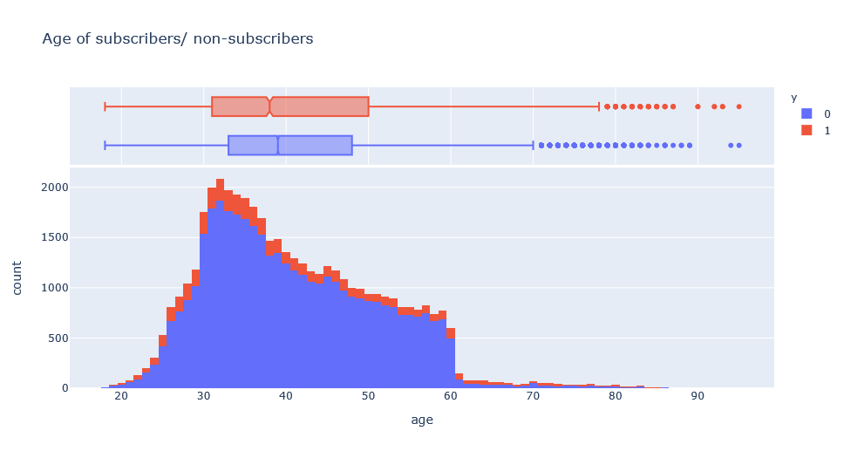
Age groups of subscribers:
The bulk of clints (subscribed or not) fall in the 30s to 40s with a steady slope to 60s which is around the age where one has built a steady career/family. This could indicate that people with families will be the main target.

Slide 6
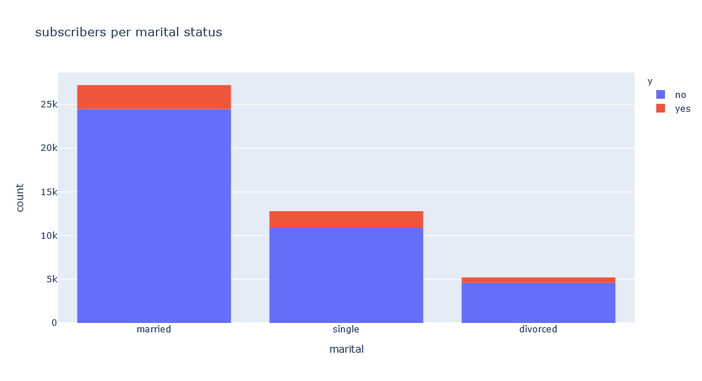
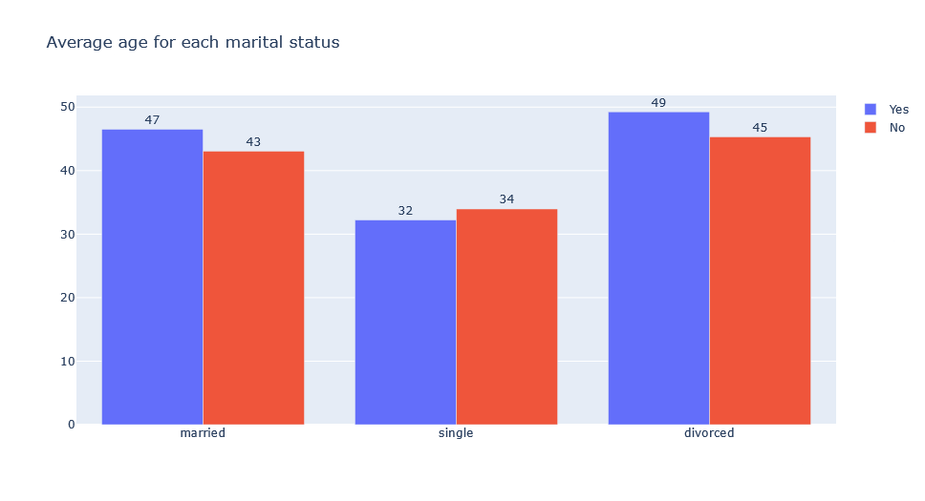
Are married clints more likely to subscribe?
It is observed that most subscribers are people with families or single (where we can assume that they have a stable career and saving for the future) which is in line with the prediction from the previous question.

Slide 7
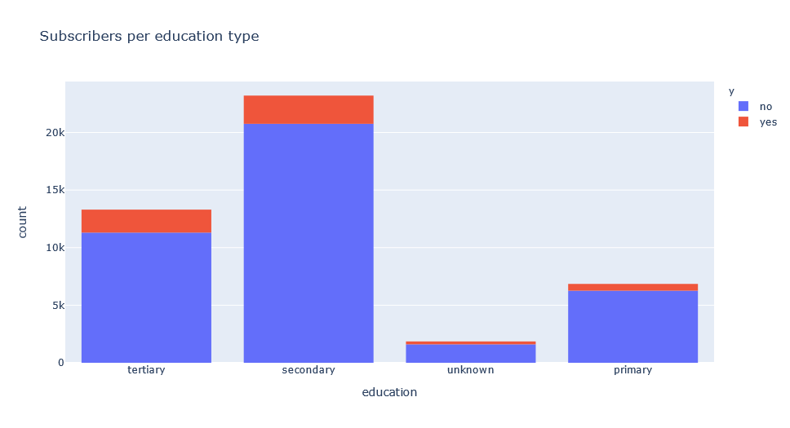
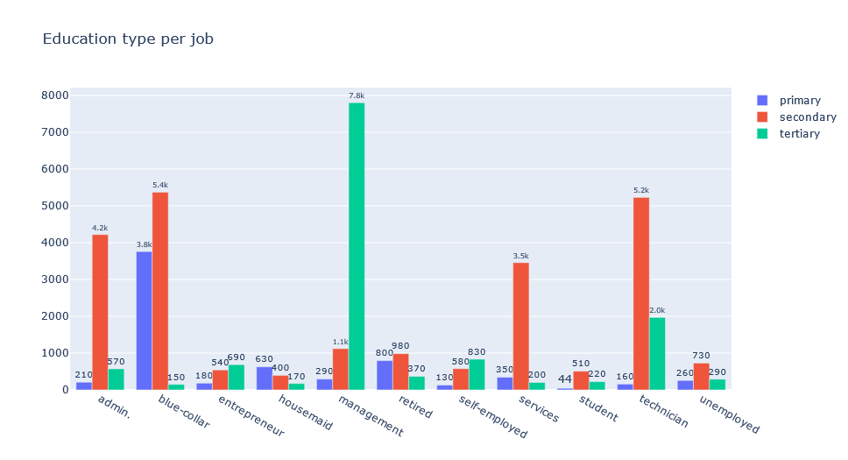
Does education play a role?
The most obtained degree is secondary (high school), and there seems to be no relation between higher education and subscribing.

Slide 8
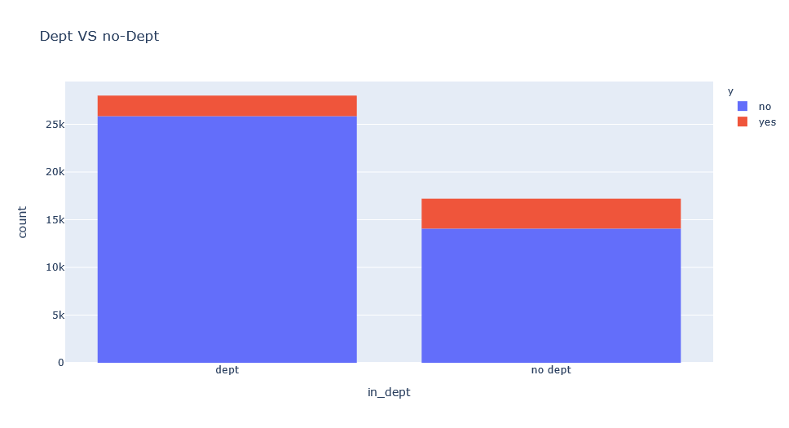
Are dept free clints more likely to subscribe?
Clints with no depts are more likely to subscribe.
A clint is in dept if they have taken either a housing loan or a normal loan.

Slide 9
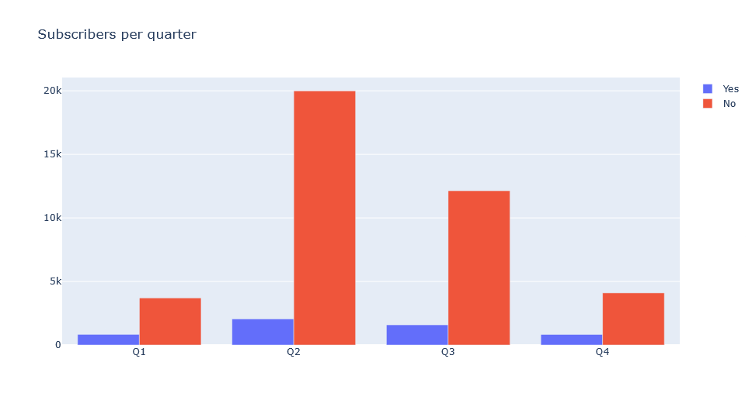
Which quarter has the most subscription?
Second and third quarters are where subscribers from previous campaigns subscribed.

Slide 10
Recommended models for this data set.
Due to the extremely unbalanced nature of the data set the up-sampling technique will be used to balance the data and to preserve the information presented in the most frequent class.
The analysis done by PCA and the correlation values both suggest that the data have little relation to each other in addition to it being a classification problem either a decision tree or a random forest will output good performance.

Slide 11
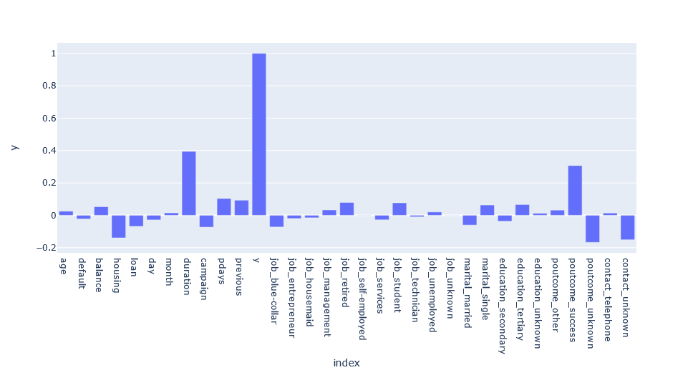
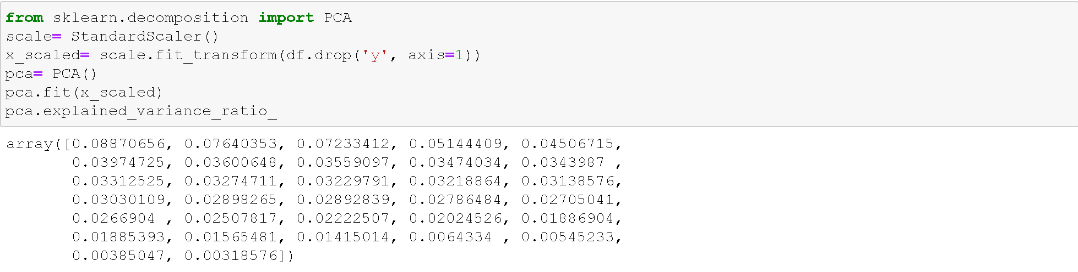
Correlation with target “y”
Explained variance ratio by PCA

Slide 12

Thank you

